Slide 1



Visualizing and Exploring Data
Business Intelligence with Tableau
Business Analytics
Neeley Graduate Program

Slide 2


Learning Objectives/Topics
Visualizations Overview
Types of data used in visualizations
Categorical and Continuous
Mini-workshops to guide in selecting appropriate visualizations
Example Data Visualizations
Histograms
Pivot Tables
BI & Visualizations with Tableau
Tableau Dashboards

Slide 3
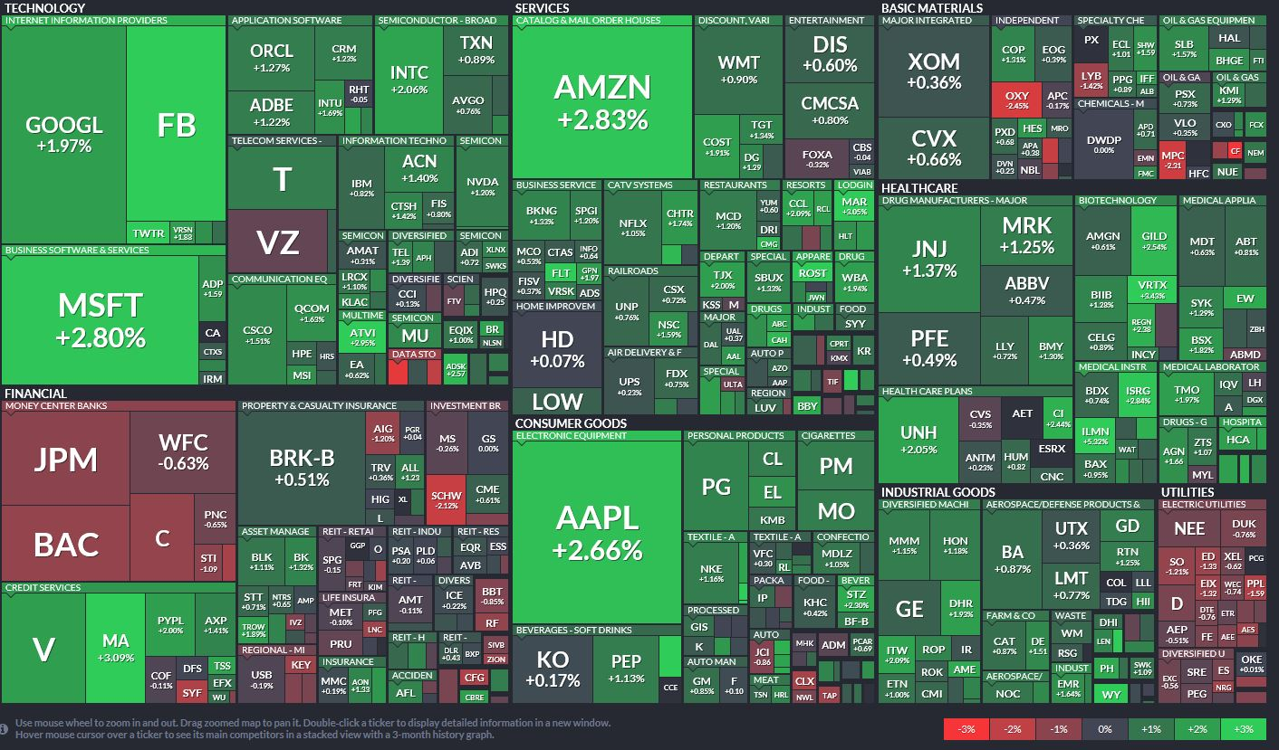

Hierarchical(treemap) Data Heat Map
https://www.finviz.com/map.ashx?t=sec

Slide 4
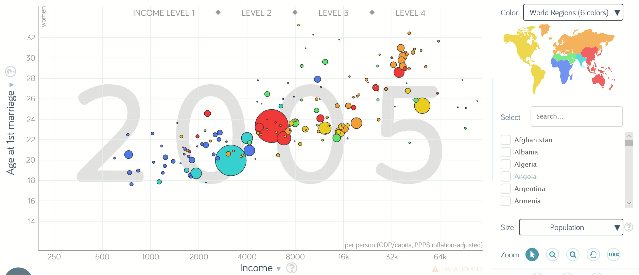
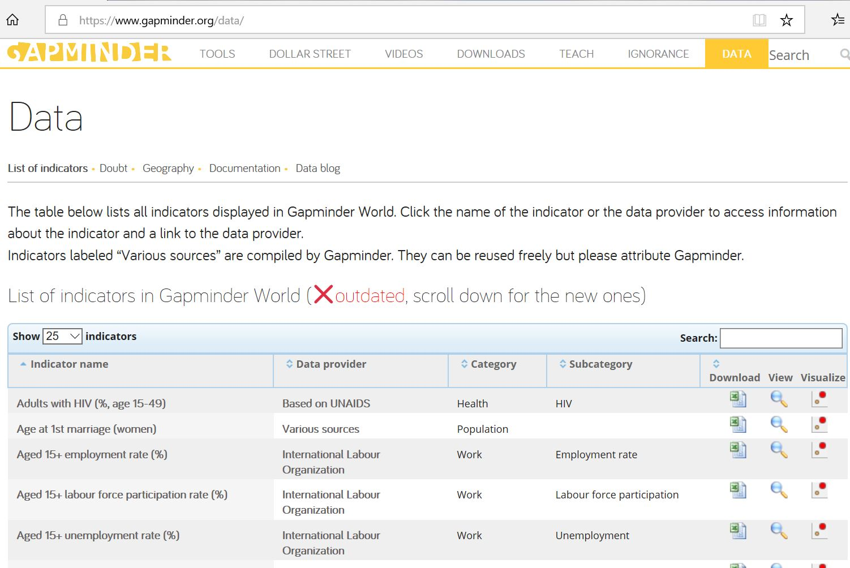

Other Cool Stuff
www.gapminder.org
Lot’s of data and interesting visualizations.

Slide 5


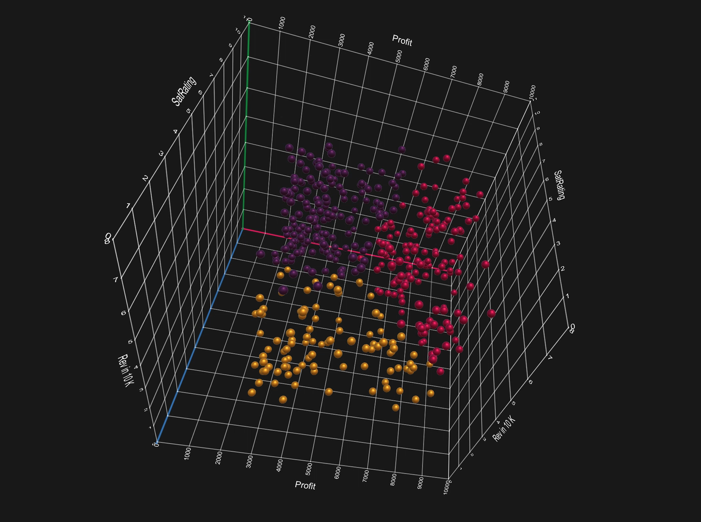
Other Cool Stuff
MS Charts 3D

Slide 6
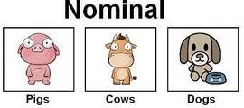
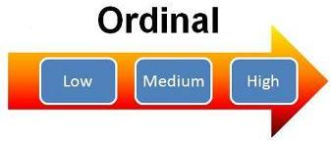

Data Classification or Types
Categorical or Nominal (qualitative)
Data that results from counting, whole numbers.
Data are sorted into categories according to specified characteristics.
There is no priority or ordering of categories.
Typically the number of observations in a category are counted up.
Ordinal
Similar to categorical or nominal data but the categories have a natural ordering.
Interval or Continuous (quantitative)
Data that results from measurement and has decimals.
There can always be another observation between two others.
Note: A frequently used type of continuous data is called time-series data. When we have two columns of data and the first column is date/time and the associated second column is a continuous (or interval) value this is considered or called “time-series” data.

Slide 7
How to select the right visualization?
Trends over time
Relationship between 2 continuous variables
Dispersion or spread
Many dimensions
Counts in categories

Slide 8
Mini Workshop 1
Use the Google Colab link to download 5 years of monthly returns data for MSFT
Download the csv file and work in Excel
Develop a chart that depicts Microsoft Stock Prices Over Time.
Develop a chart that depicts the relationship between MSFT returns and the market overall (S&P 500 index).
What kind of data is this?
What would be an appropriate way/chart to visualize this data?
How is the data trending?
Describe relationship observations.

Slide 9
Mini Workshop 2
Download the file, BeerBrandPref.xlsx
Brand Preferences and Gender
What kind of data is this?
What would be an appropriate way/chart to visualize this data?
How would you summarize the data overall?
What is the data telling us regarding the brand preferences and gender?
Create some useful charts/visualizations.

Slide 10
Mini Workshop 3
Download the file, Salary.xlsx
Age and Salary data
What kind of data is this?
What would be an appropriate way/chart to visualize this data?
How would you summarize the data overall?
What is the data telling us regarding ages and salaries?
Create some useful charts/visualizations.

Slide 11
Mini Workshop 4
Use the Google Colab link to download TSLA monthly data
5 years of monthly returns
What kind of data is this?
What would be an appropriate way/chart to visualize this data?
How would you summarize the data overall?
Create a useful charts/visualizations.
What is the Beta of this equity? How reliable is this metric?

Slide 12
Mini Workshop 5
Download the file, PurchaseOrders.xlsx
What kind of data is this?
What would be an appropriate way/chart to visualize this data?
How would you summarize the data overall?
Create a useful charts/visualizations.
Students will be asked to discuss for participation.

Slide 13
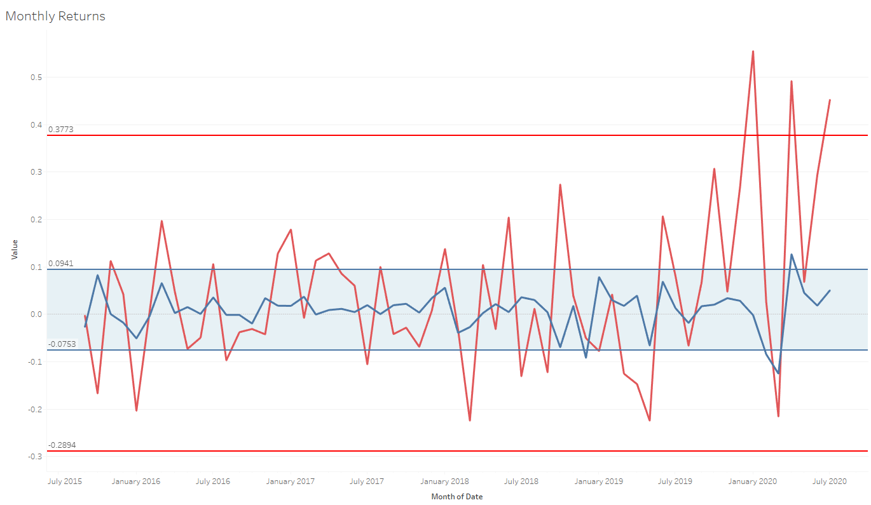
Line Chart, Time Series, TSLA Returns vs Market
+ / - 2 standard deviations
57/60, 95% within

Slide 14

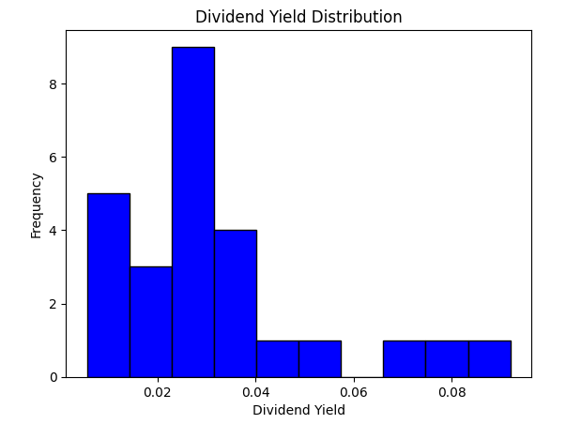
Histogram, Spread / Dispersion in a Continuous Variable
Available at our class site under Google Colab 😃

Slide 15
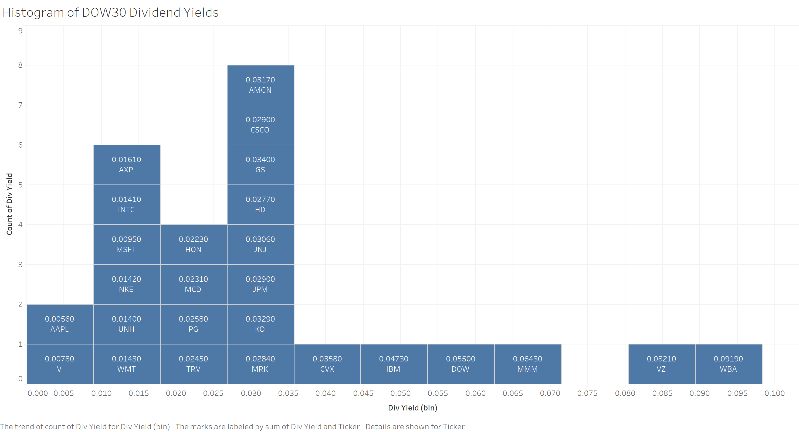
Histogram, Spread / Dispersion in a Continuous Variable

Slide 16
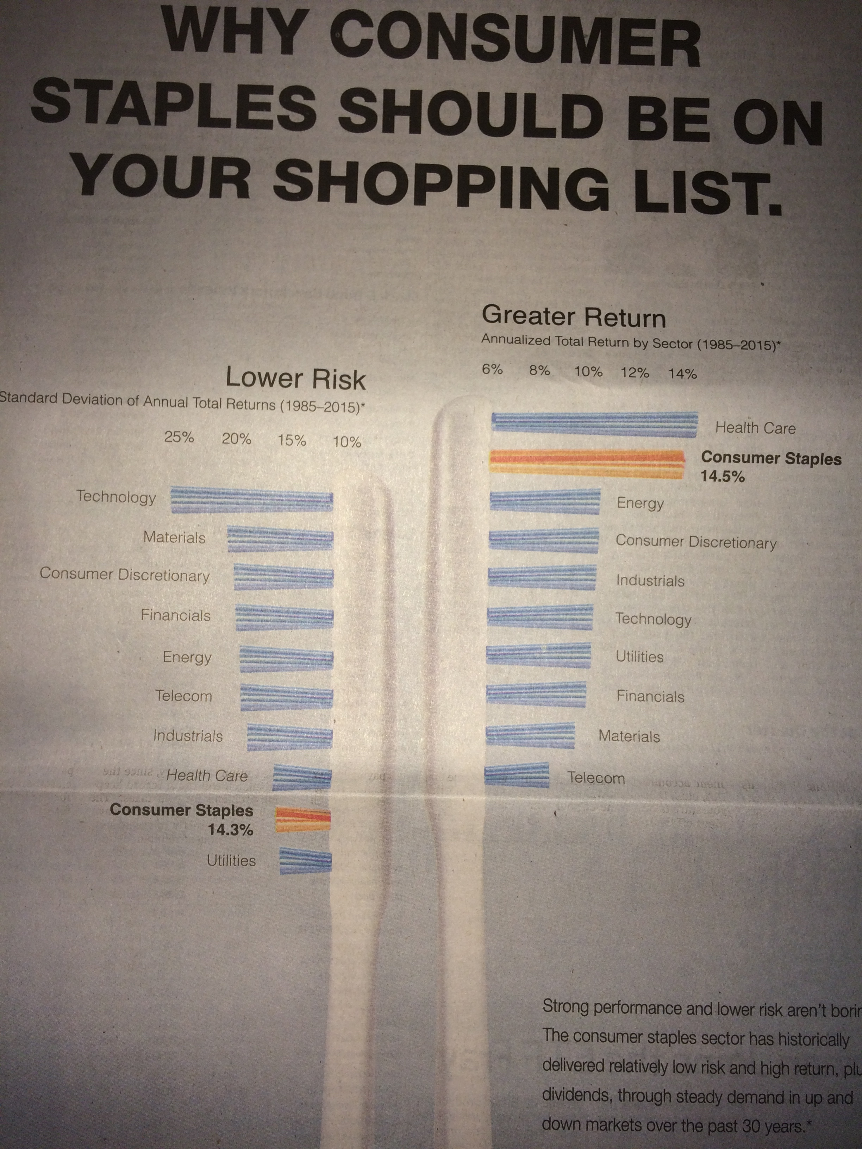

Slide 17

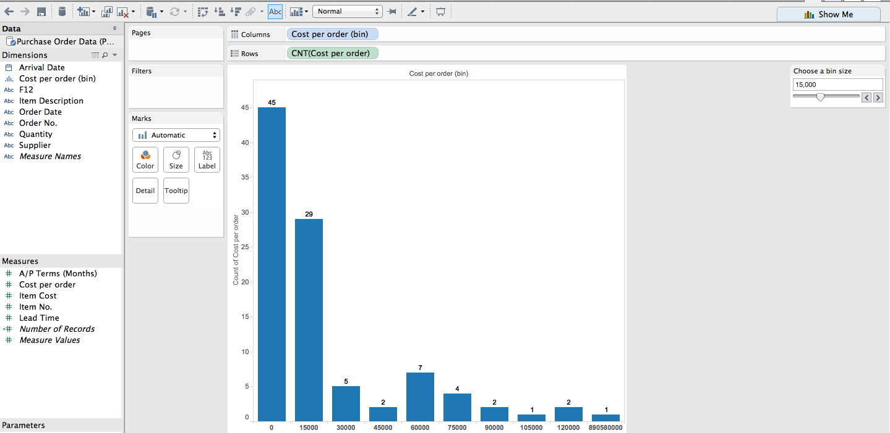
How to select the right presentation of the data?
Histogram, In Tableau
Purchase Orders File

Slide 18

Histograms
Become an expert at building histograms. This skill will help you in other courses as well as in your business career.
Histograms give you a nice picture of the way the data is dispersed.

Slide 19
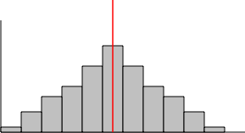
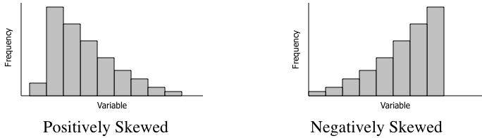
Histogram Shapes, Skewness

Slide 20
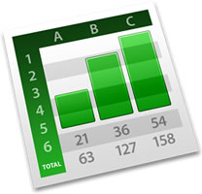

PivotTables
Data Summarization Tool
Sort, Count, Average, Total Items/Fields of Interest
Drag and Drop Fields
- Columns and Rows May Be Rotated or Pivoted
“Mini” Data Crunching Method

Slide 21
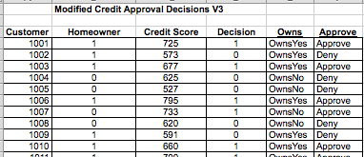
PivotTable, Cross Tabulations Modified Credit Approval Decisions V3 file
Getting Excel to make the table using PivotTables.
Each record needs a row identifier.
We want to see counts of loan Approvals (Decision=1) and Denials (Decision=0) by whether or not the applicant/customer is a homeowner.
We want to determine whether or not home ownership is an important factor in the loan approval decision.
n=50

Slide 22
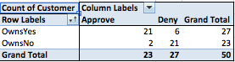
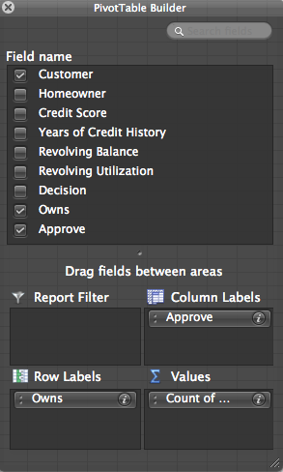
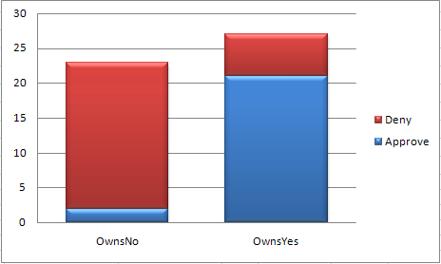
PivotTable, Cross Tabulations
It is clear most loan Approvals are for those that Own homes.
Most loan Denials are for those that do Not Own.

Slide 23
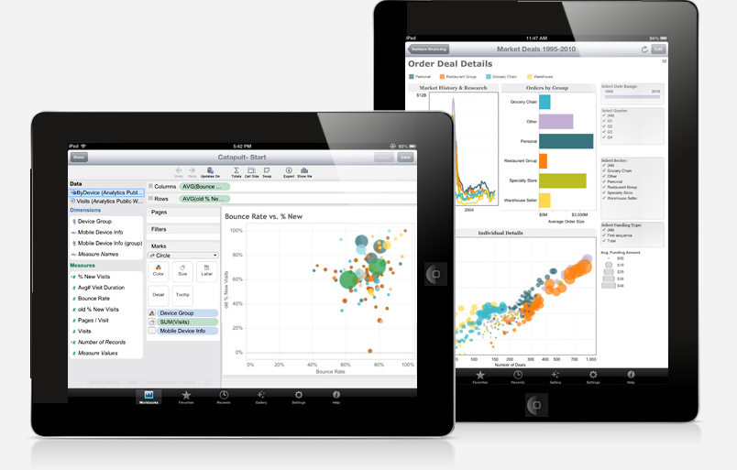
Tableau
See Tableau Step-By-Step PPT Slides.

Slide 24
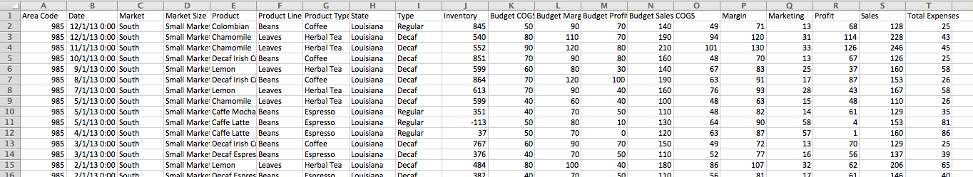
Tableau
Coffee Chain Data (database)
Over 4000 transactions in 2012 and 2013.
Show total sales (2012 and 2013) for each product grouped within Product Type grouped within Product Line.
Show total sales by market region. Show total sales by state within each market region.
Show a geo map of total sales in each state.
Show total sales for each market (Major and Small).
Budgeted or planned profit grouped by Product Type.
Time series sales of time grouped for each Product Type.
Sales and profits over time by Product Type.
Total sales and total profits for each Product Type. Then filtered for states of interest.
Cross Tab table that displays the number of sales of each product within each product type.
Drill down showing total profit by Product Line, Product Type, and individual Products.
Combo chart budget sales and actual sales over time.
Calculated field ratio of actual profit to budgeted profit for each product overall for the two years.

Slide 25
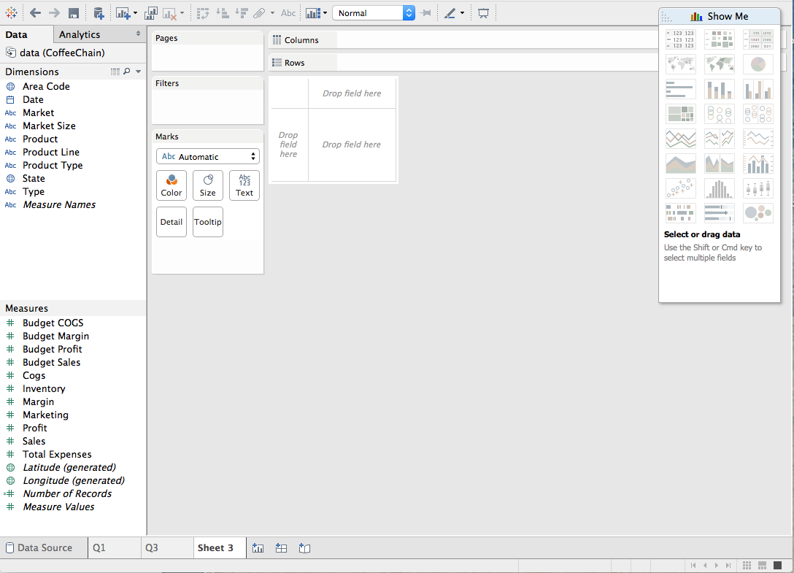
Worksheet
Categorical Data
String or Text
Dates
Continuous Data

Slide 26
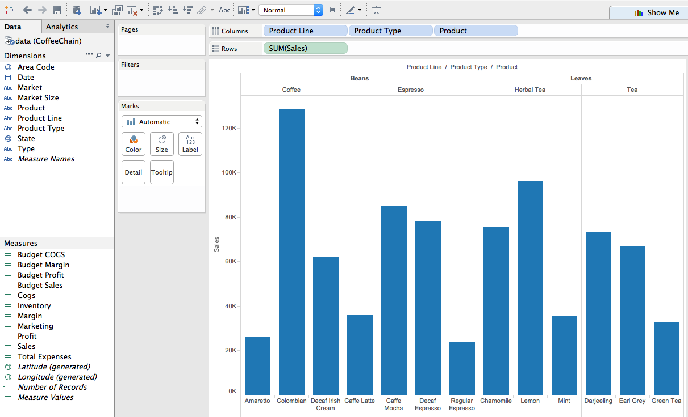
Tableau
Coffee Chain Data (2 Product Lines, 4 Product Types, 13 Products)

Slide 27
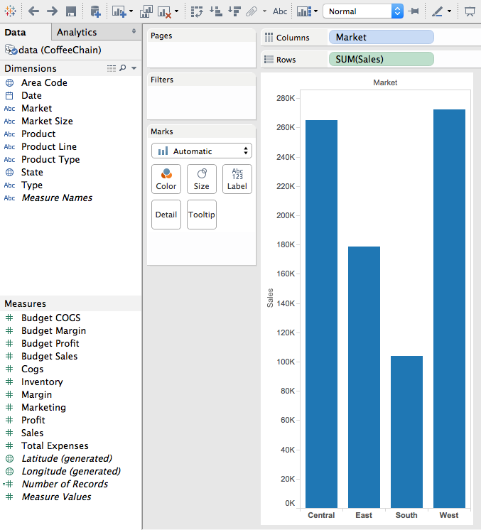
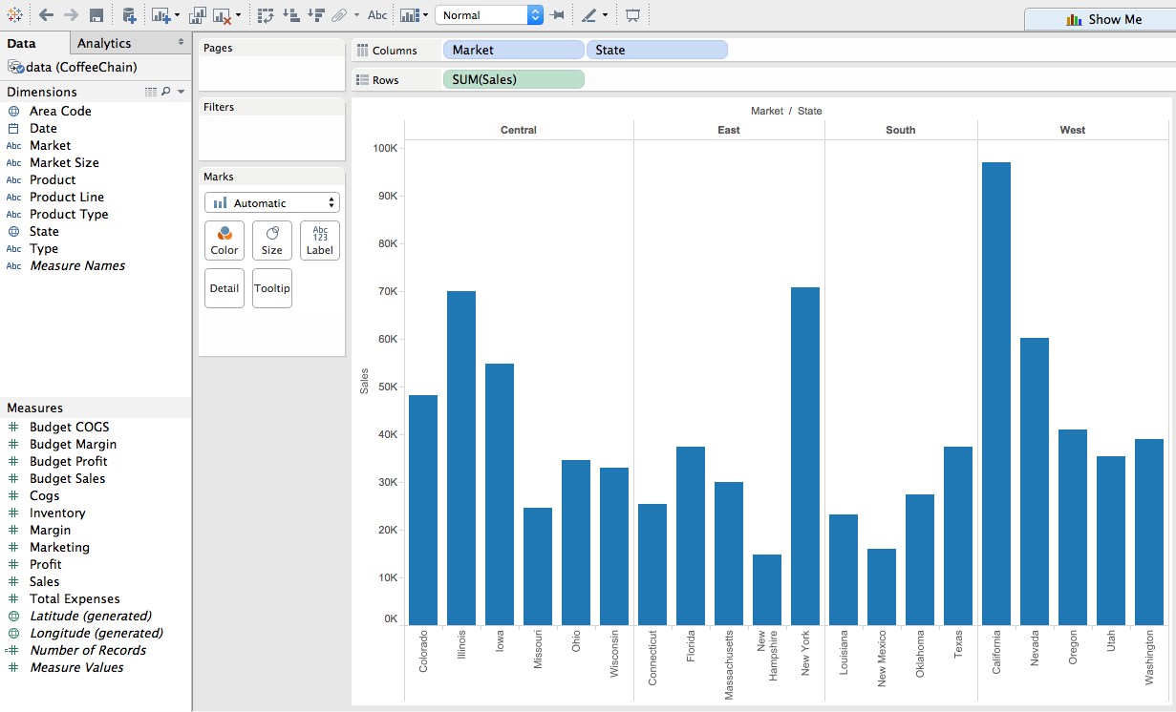
Tableau
Coffee Chain Data (4 Markets/Regions) (States within Markets)

Slide 28
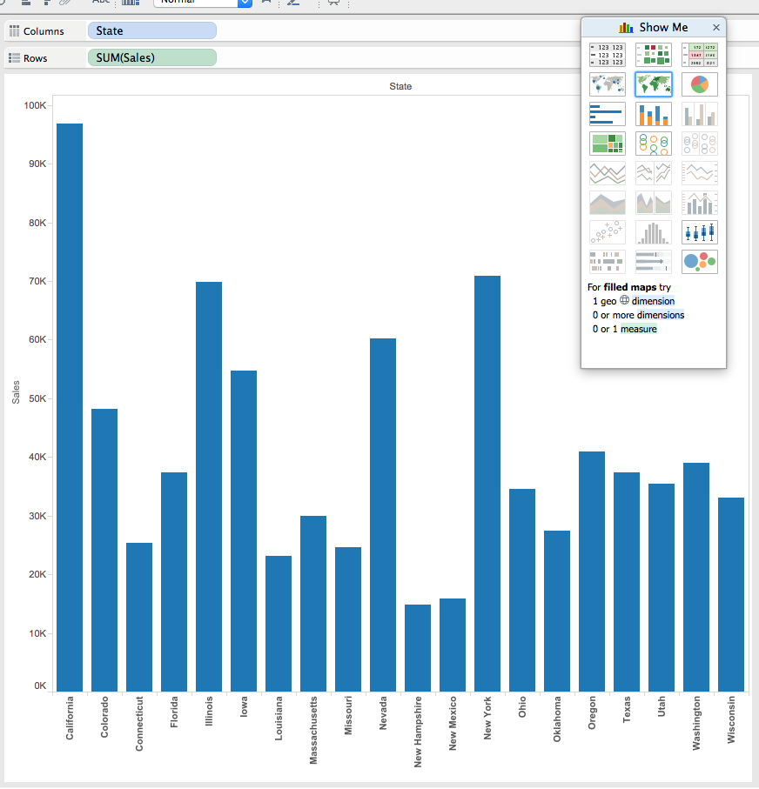
Tableau

Slide 29
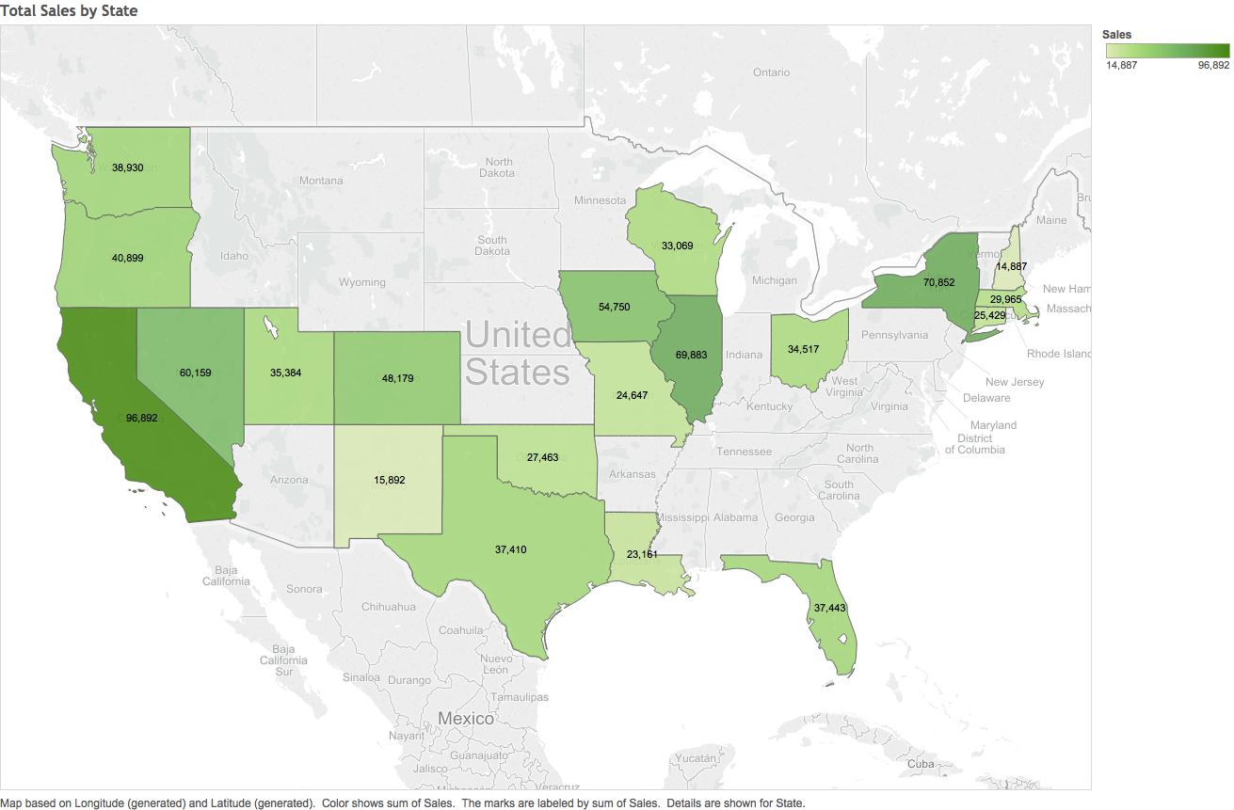
Tableau

Slide 30
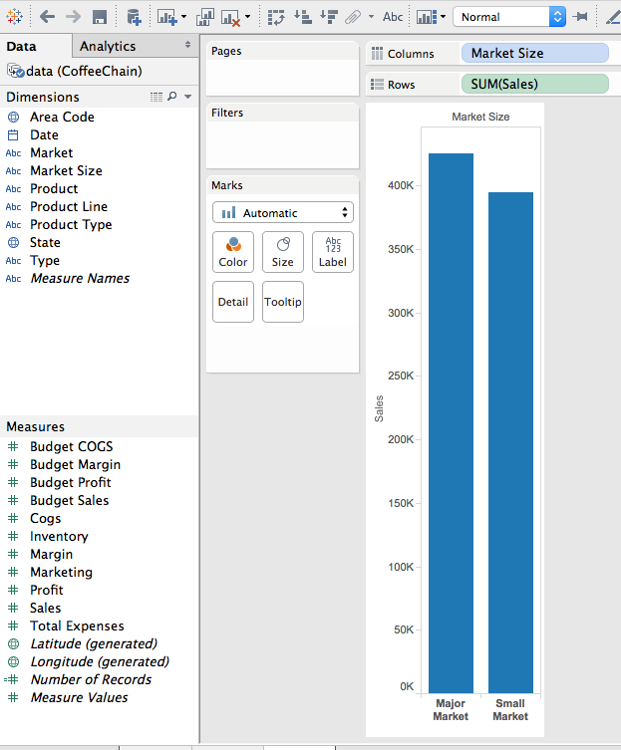
Tableau
Coffee Chain Data (2 Market Sizes)

Slide 31
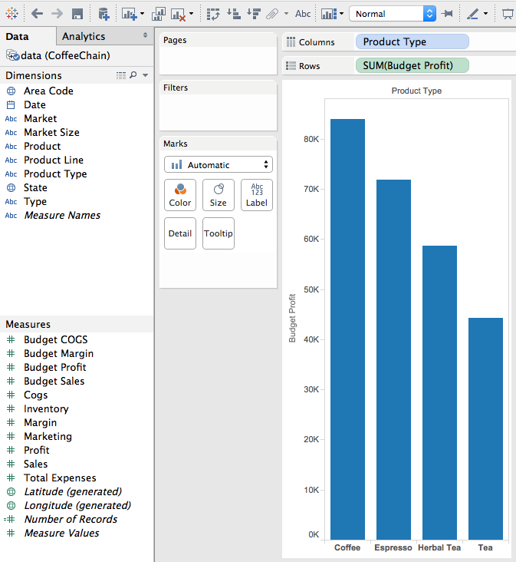
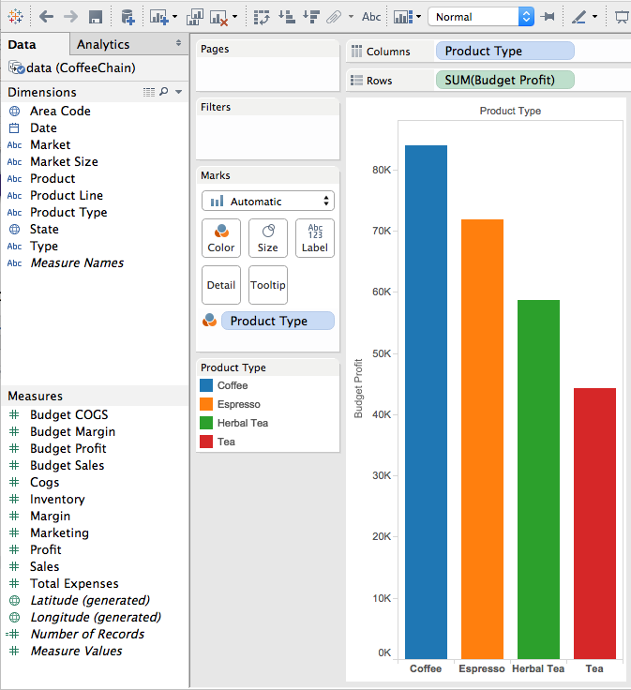
Tableau
Budgeted Profit and grouped by Product Type.
Drag Product Type from Dimensions to Color, under Marks.

Slide 32
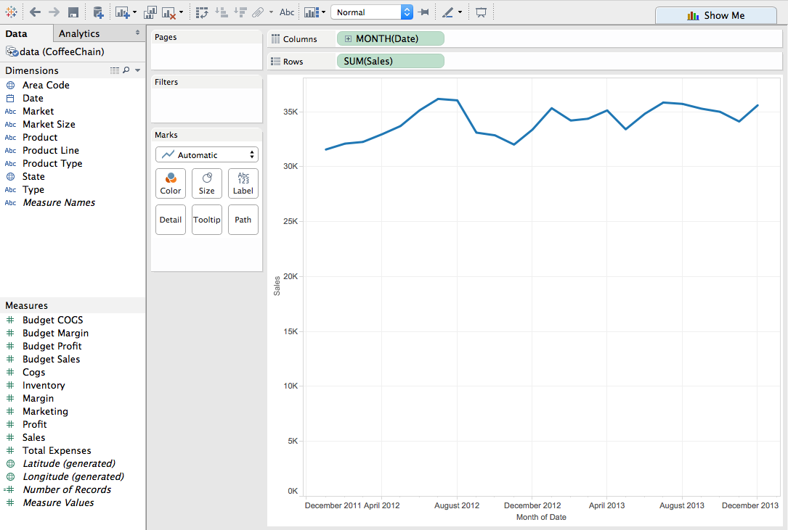
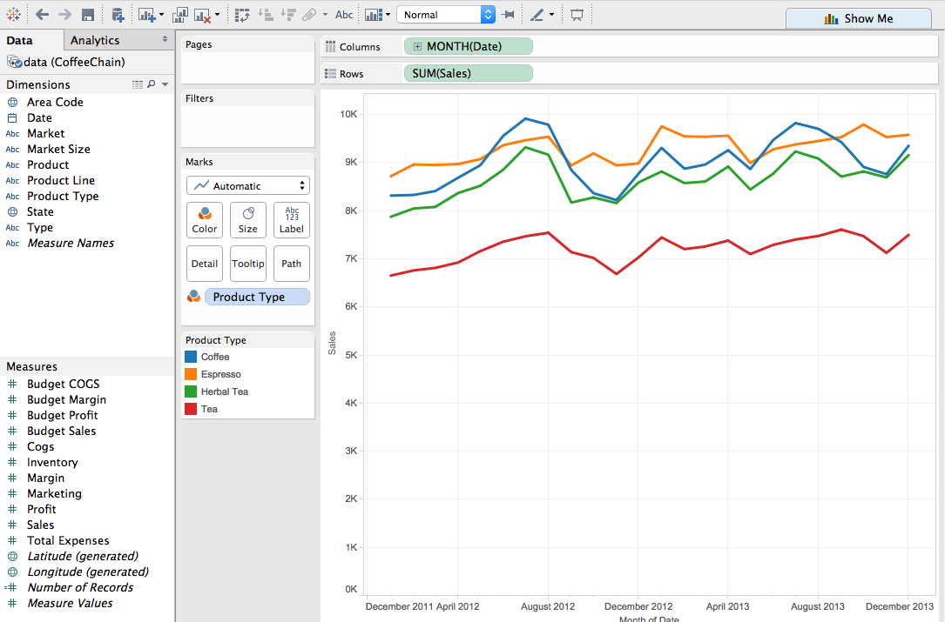
Tableau
Sales and Profits over time.
Drag Product Type from Dimensions to Color, under Marks.

Slide 33
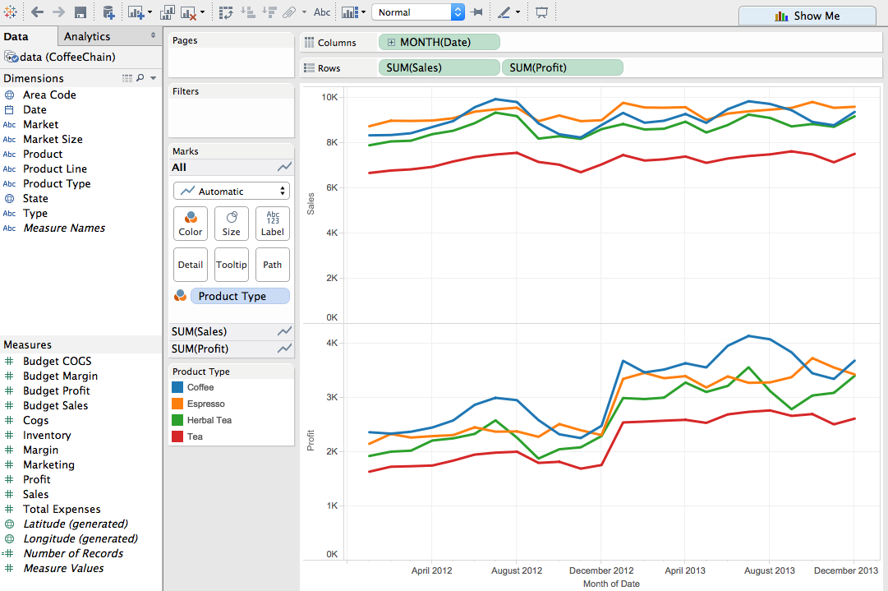
Tableau
Sales and Profits over time.

Slide 34
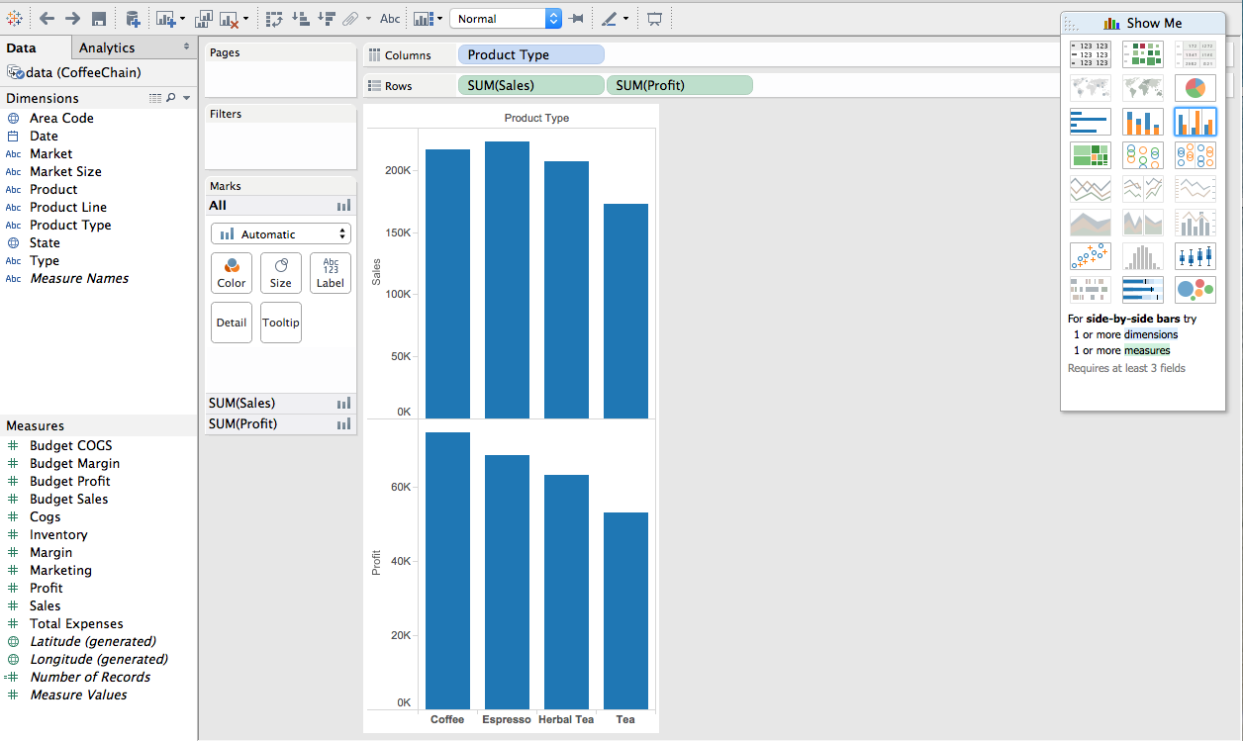
Tableau
Total Sales and Total Profits (grand totals).

Slide 35
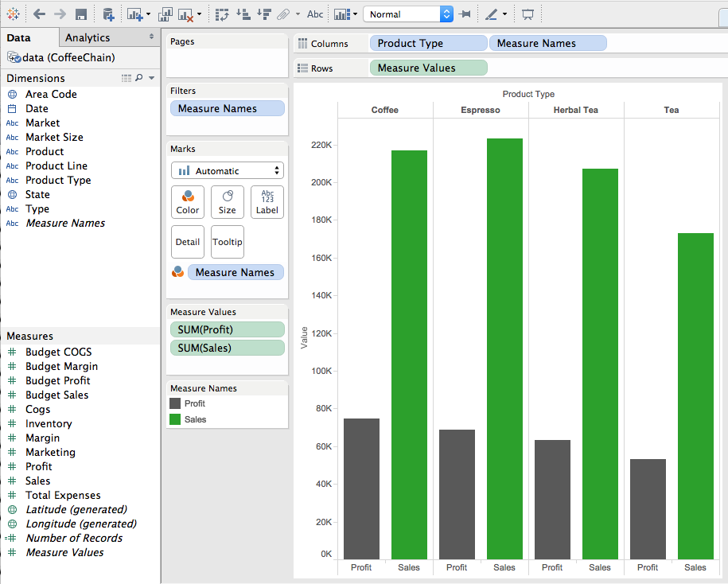
Tableau
Total Sales and Total Profits (grand totals).

Slide 36
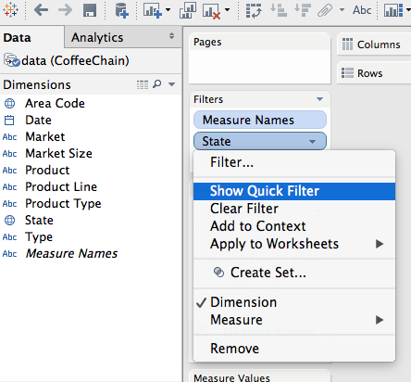
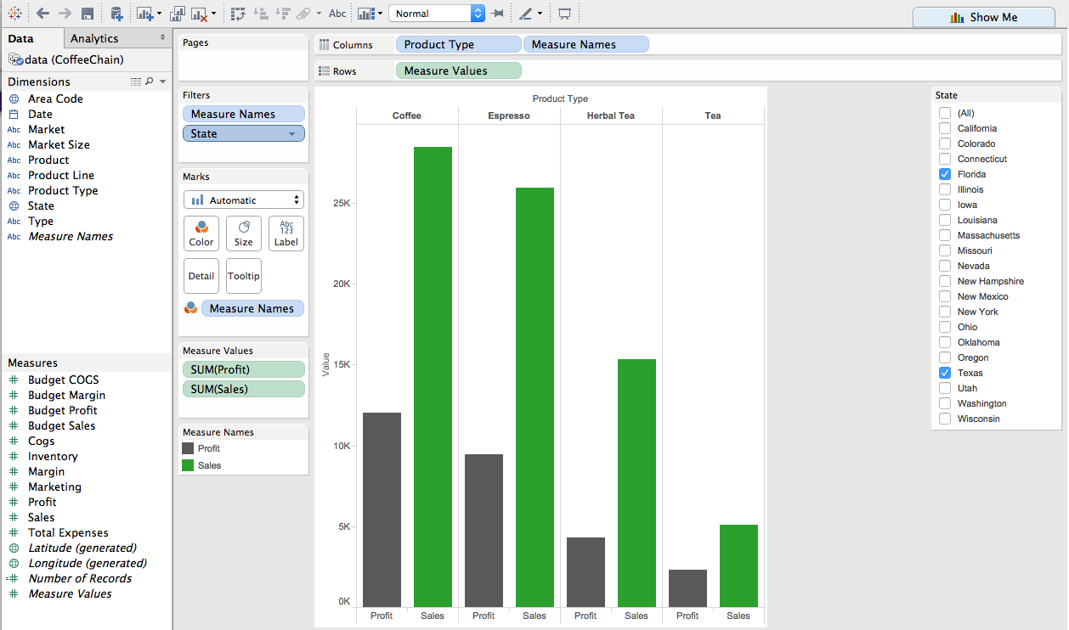
Tableau
Total Sales and Total Profits (grand totals). One or multiple states.
Drag State from Dimensions to Filters.
Select Show Quick Filter.

Slide 37
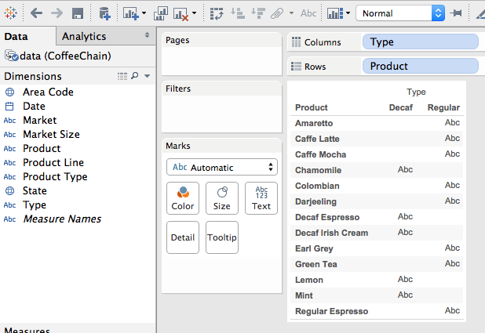
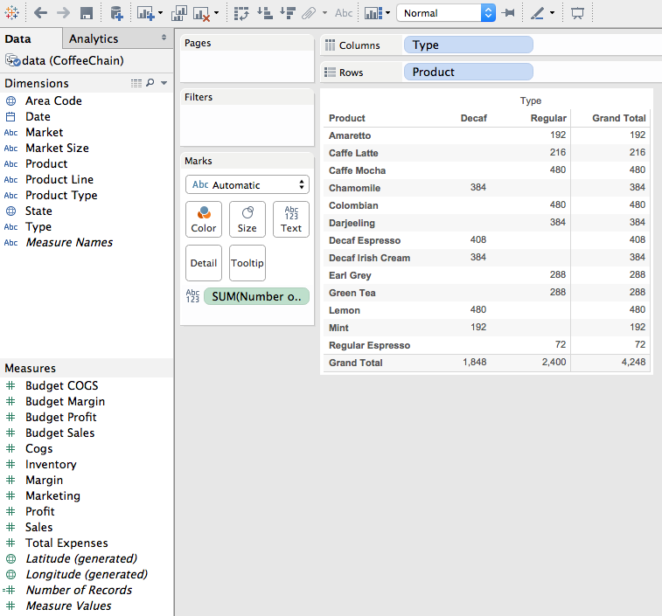
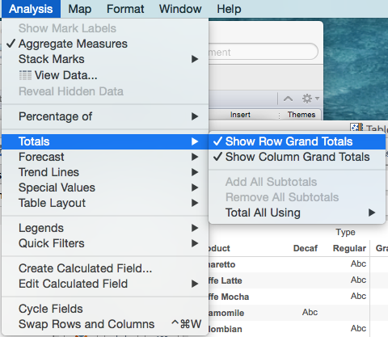
Tableau
Cross Tab Tables. Typically Columns and Rows are Categorical data for cross tabulations.
Drag Number of Records (or Sales, or other attribute) from the Measures shelf right into the center of the worksheet.

Slide 38
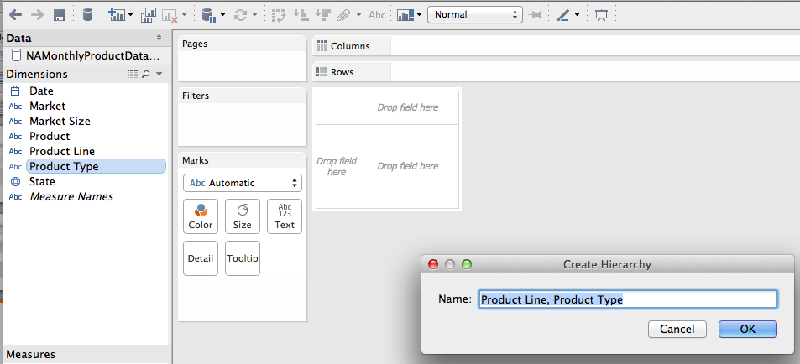
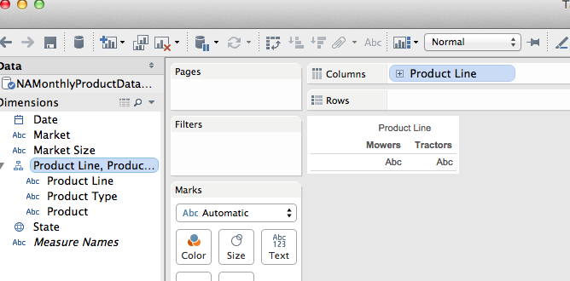
Tableau
Drill Down.
Drag product type on top of product line.
Drag product below product type.

Slide 39
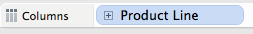
Tableau
Drill Down.
Drag the Product Line hierarchy onto the Columns.
By clicking the + sign you can expand (drill down) from Product line to Product types, then to Products.
Drag Profit onto the Rows.
Drag State into the Filter space, then select California.
Click the Labels shelf and check the show mark labels.
Drag Profit onto the Color square, under Marks.

Slide 40
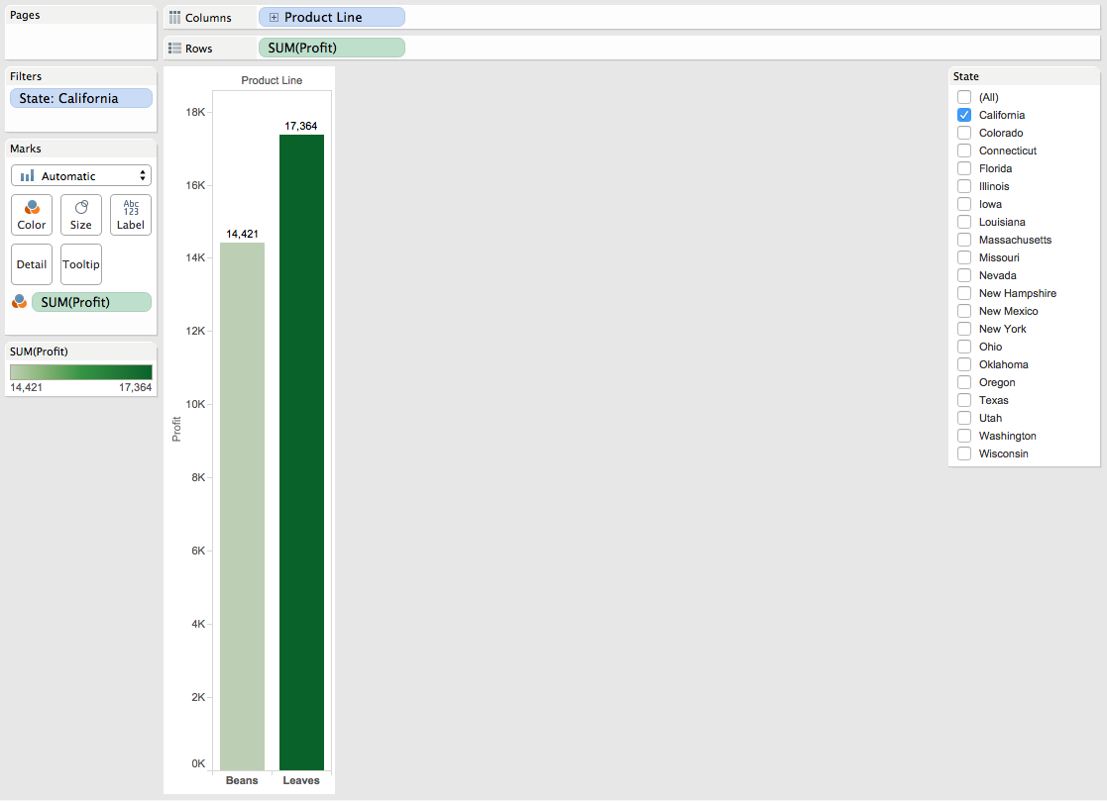
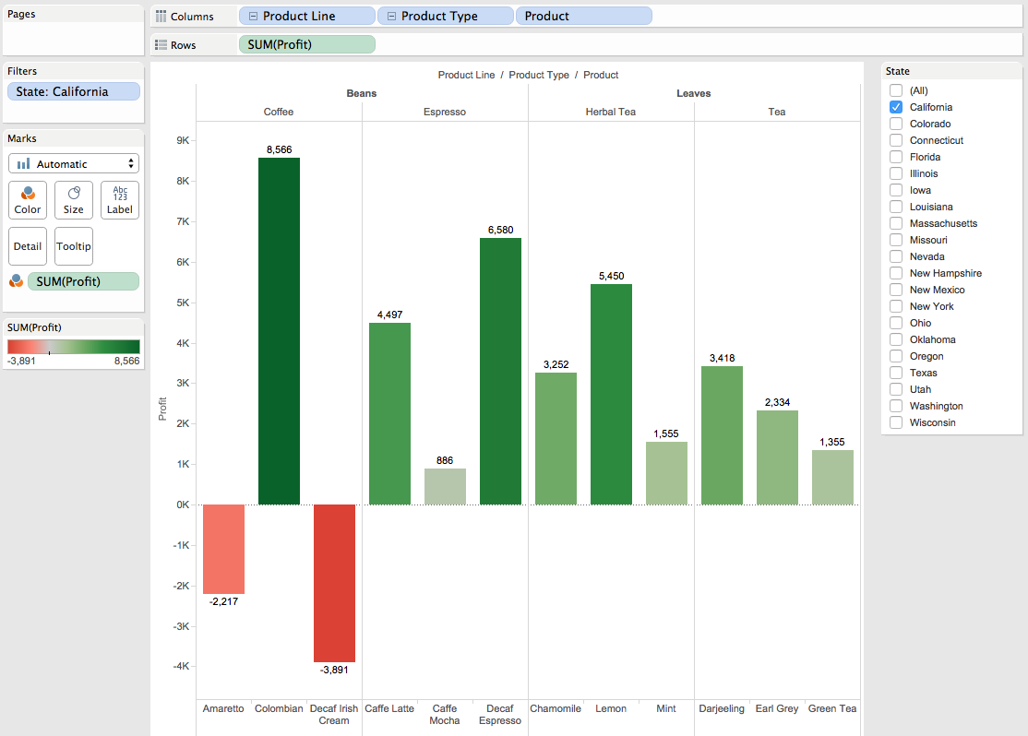
Tableau
Drill Down.

Slide 41
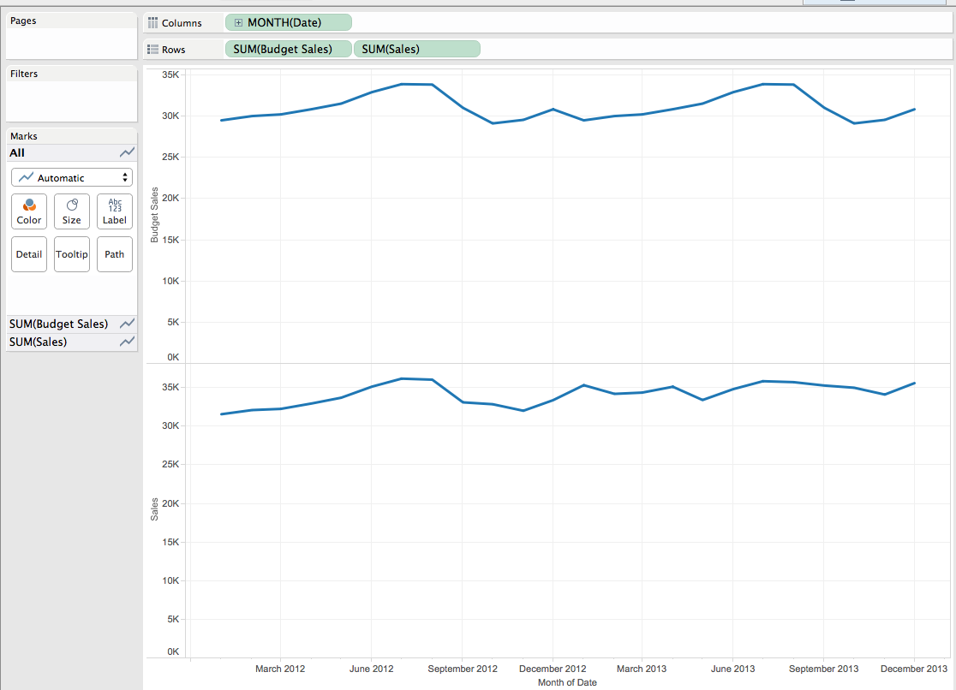
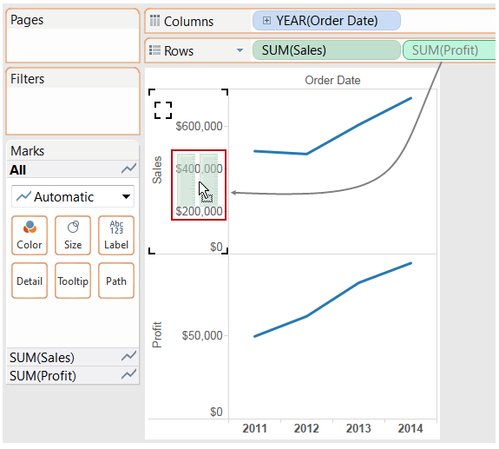
Tableau
Putting Budgeted Sales and Actual Sales on the same chart over time.

Slide 42
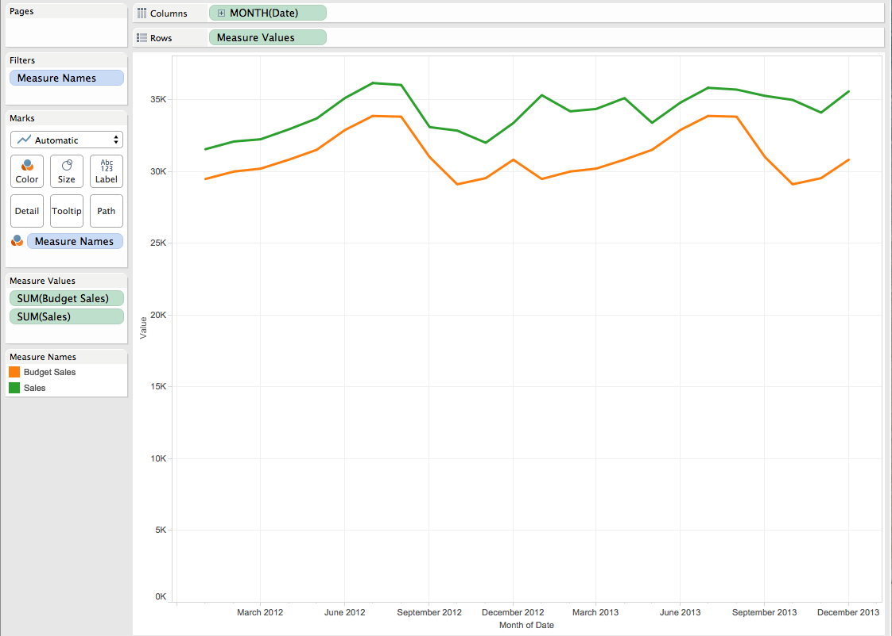
Tableau
Putting Budgeted Sales and Actual Sales on the same chart over time.

Slide 43
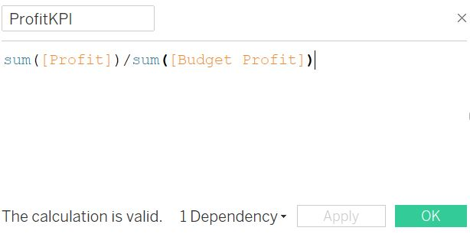
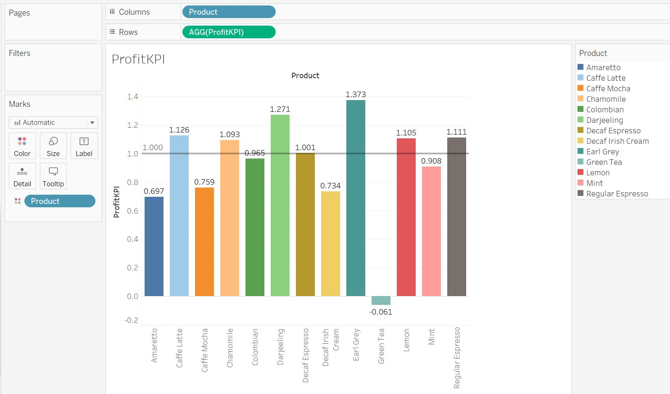
Tableau
Ratio of actual profit to budgeted profit by product, creating and visualizing a calculated field.

Slide 44
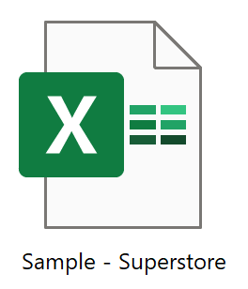

Dashboards

Slide 45



Tableau Dashboards Notes
create a parameter
create a calculated field
In the dashboard Category column chart, click the use a filter.
In the first worksheet for the dashboard, edit the calculated field metric amount to “apply to all using this data source”.

